Slide 1


Machine learning for physics and astronomy chapter 1
Viviana Acquaviva

Slide 2
What is machine learning?
THE PROCESS OF
TEACHING A MACHINE TO MAKE DECISIONS

Slide 3
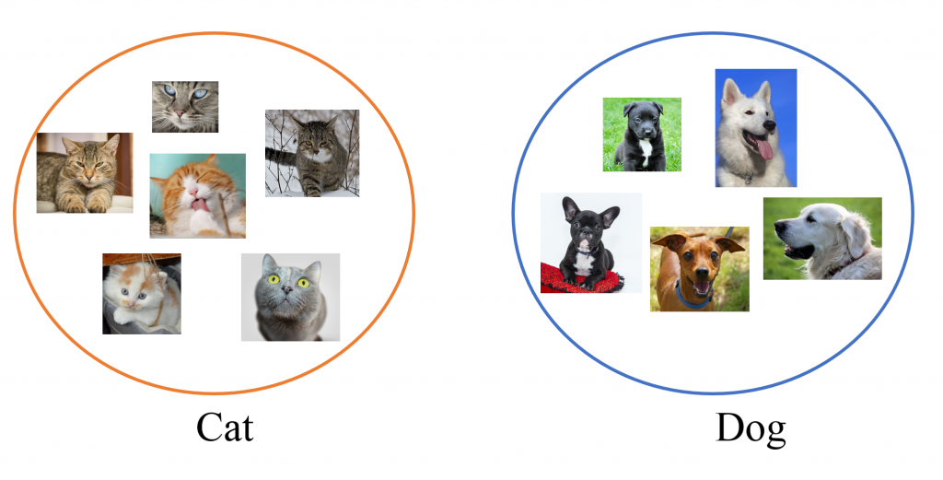
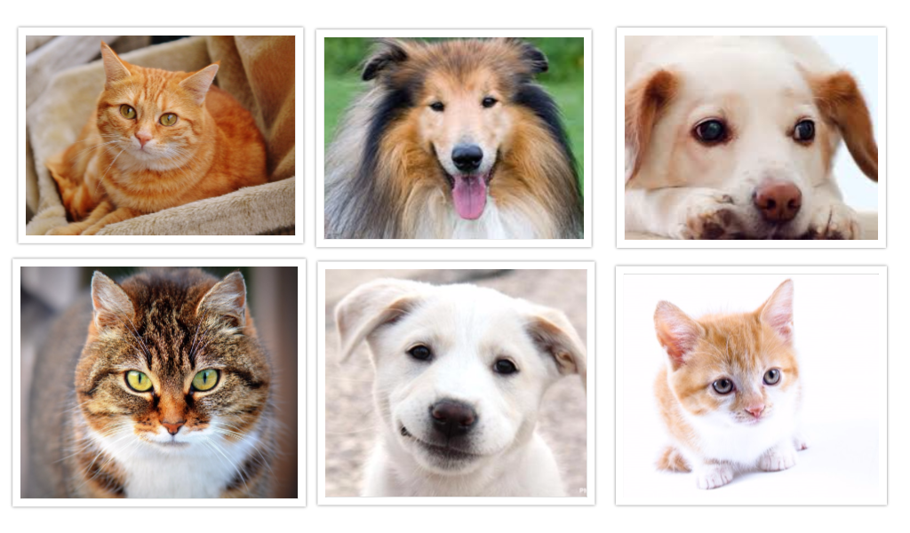

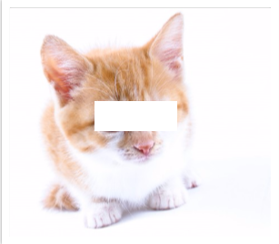


THE PROCESS OF TEACHING A MACHINE TO MAKE DECISIONS
Group together
Recognize
Predict
Simplify
Notes:
http://manmax31.github.io/deep/learning/2016/03/19/Neural-Network-using-Tensorflow.html

Slide 4

Machine Learning is a set of tools. A lot of it is nicely packaged linear algebra. Like all tools, you need to know how and when to use it.
What is machine learning?
Not a black box!
Not a magic wand either!
Expecto
Predictions!
Human factor is essential. I’ll try to show how.
Notes:
Images licensed from AdobeStock

Slide 5
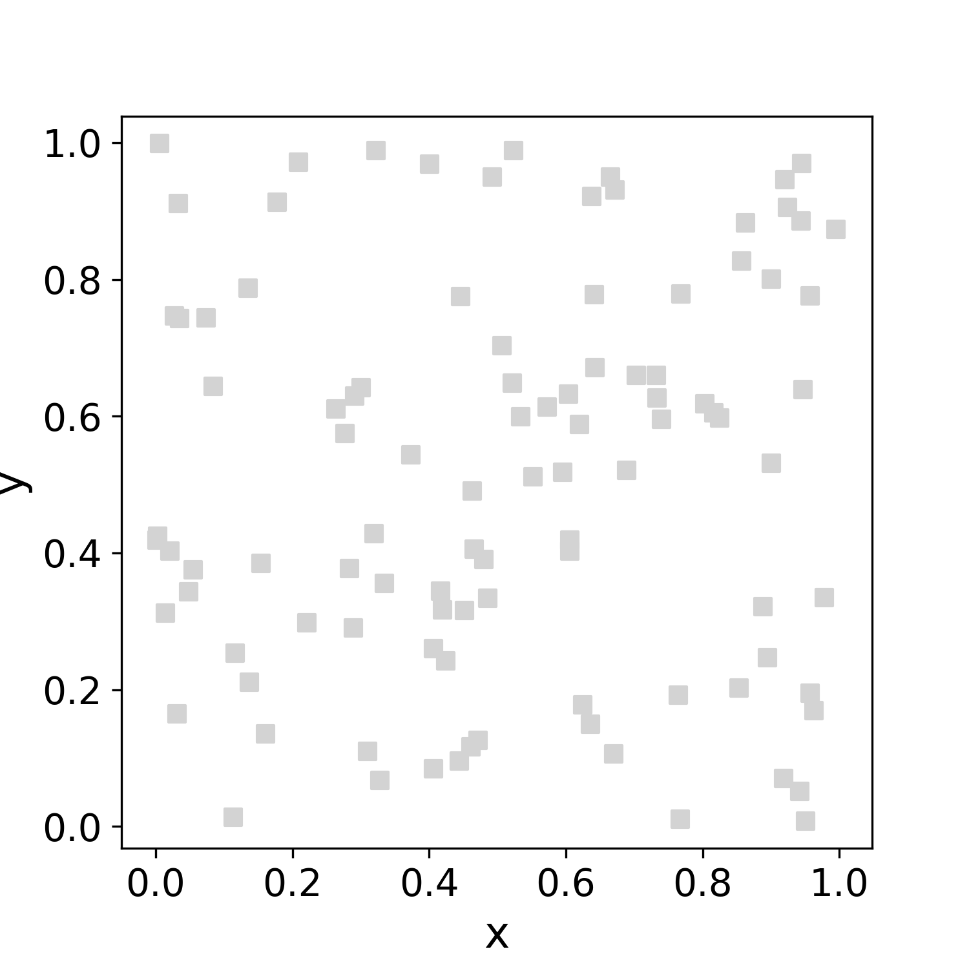
Our brain machine learns

Slide 6
Our brain machine learns

Slide 7
(of course) ML is not the only way
I can also create a probabilistic model to predict color from coordinates.
1. What would be
the ingredients?
2. What would I be
estimating?
Notes:
That’s why it’s so connected to AI and some times difficult

Slide 8
ML vs inference; the many meanings of “model"
In classic inference problems, we make a model, define its parameters, and then measure those parameters (in this case, slope and intercept).
In ML approaches, the emphasis is on a path to a decision.
(a ML model will return whether the point is blue or green, given the coordinates, and will generally not return the parameters).
This doesn’t mean that no assumptions are made on the possible mathematical relationships between input and output.
In ML jargon, a MODEL is the object that returns an output (e.g., color) from the input (e.g., coordinates).
The set of possible relationships between input and output is a method, or algorithm.
Random Forests, Neural Networks…. are examples of algorithms.

Slide 9
MACHINE LEARNING JARGON
Features are observable quantities, known for all objects (input)
Label or Target is the property that we want to predict (if it exists)
Instances (or examples) are the objects in our data set
In this case…?

Slide 10
SUPERVISED MACHINE LEARNING
The desired output is an unknown quantity (label or target) that we’d like to predict from the input features
2. we learn BY EXAMPLE: we need a set of objects with known labels. This is called the LEARNING SET
How many
instances in
our learning set?

Slide 11
Size and quality of the learning set are very important
INPUT | OUTPUT
one | 3
two | 3
three | 5
four | 4
five | 4
six | ?
INPUT | OUTPUT
1 | 3
2 | 3
3 | ?
Data representation
(sometimes called feature engineering)
and determining whether you have enough data to create a good model are crucial.

Slide 12
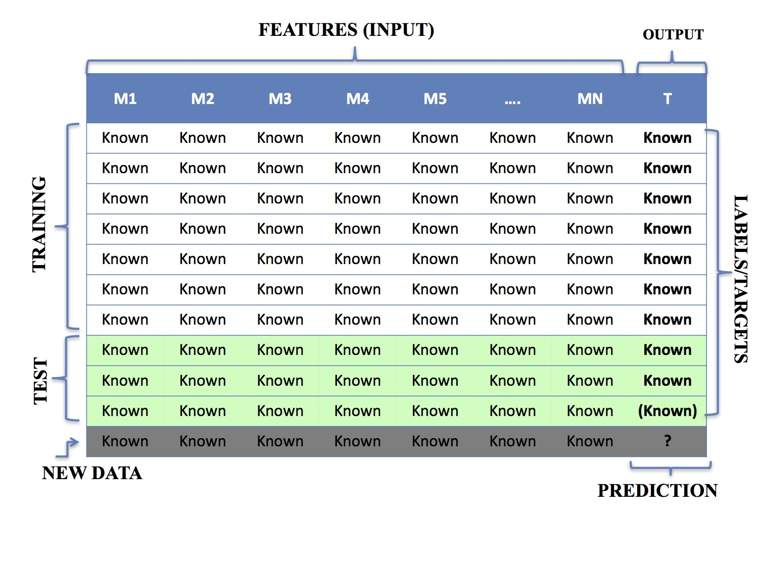
SUPERVISED LEARNING VISUAL SUMMARY
INSTANCES
In LEARNING SET

Slide 13
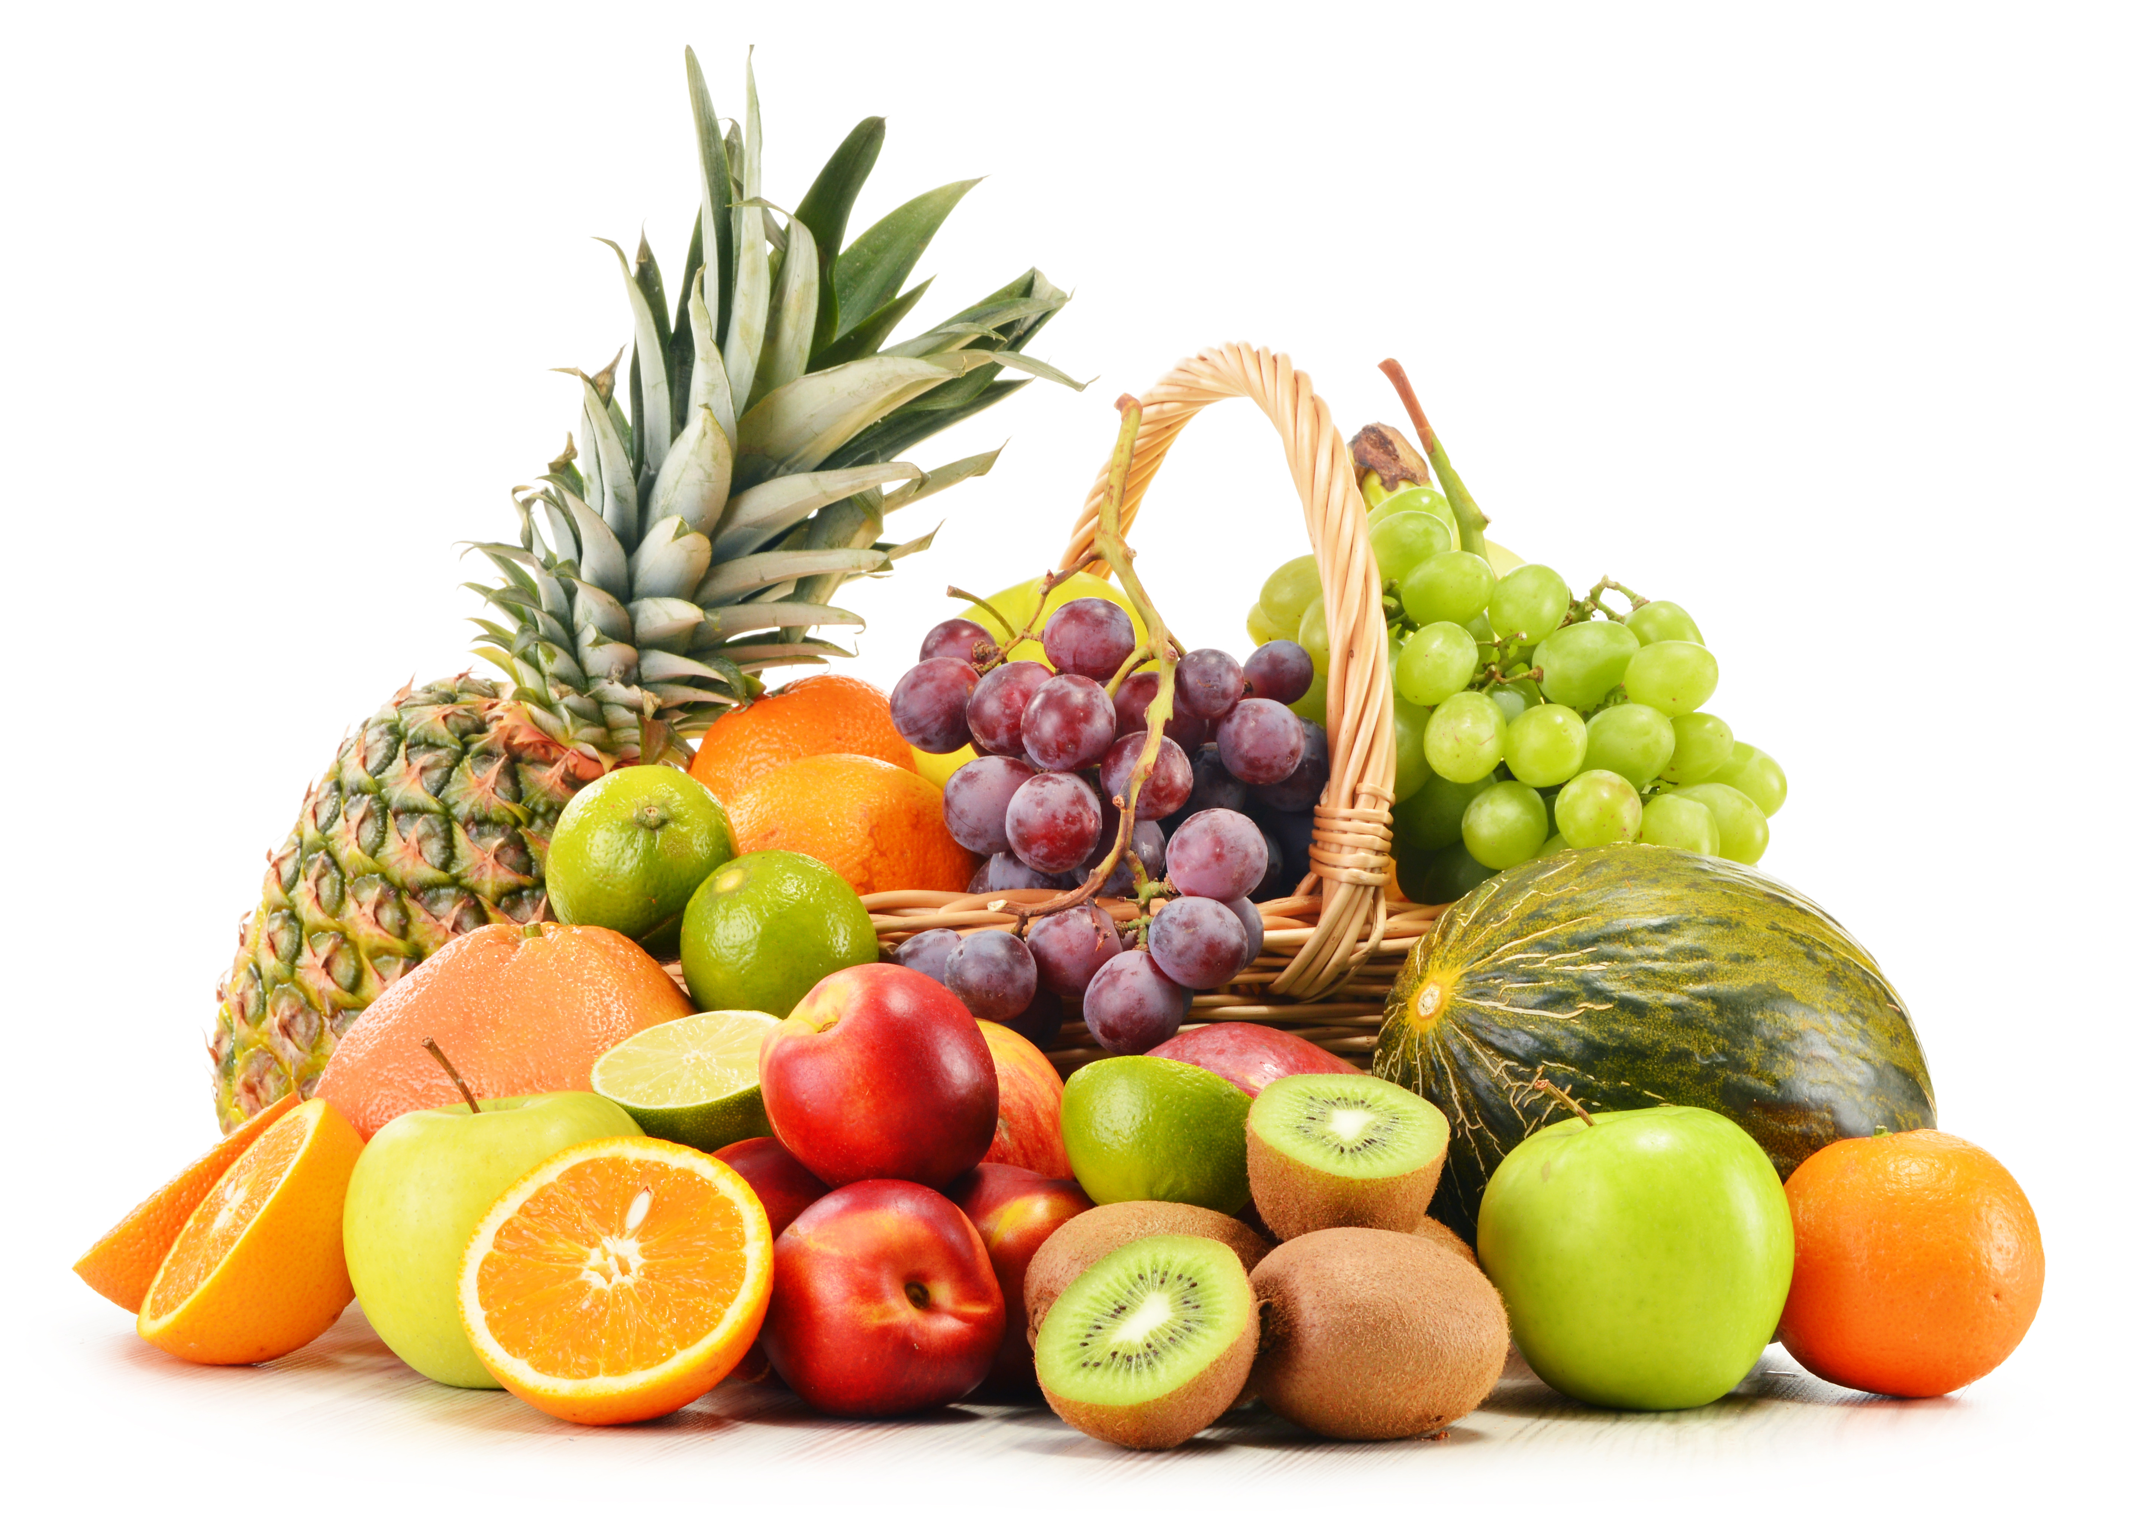
Regression vs. classification
We talk about classification when the target is a discrete variable (or class).
Let’s look at this image recognition problem:
There are a finite (how many?) numbers of possible outcomes.
Notes:
Image licensed from AdobeStock

Slide 14

Regression vs. classification
We talk about regression if the outcome is a continuous variable.
For example, if I am trying to predict the probability that it will rain in a hour based on the current weather conditions, the outcome (target) is a continuous variable that can have all values between 0 and 1.
What if I was trying to decide whether I should bring an umbrella?
Notes:
Image licensed from AdobeStock

Slide 15
Regression vs classification
Often murky: many problems rely on the idea of a “threshold”
For example, the decision about bringing an umbrella can be re-cast as estimating probability that it would rain, and the saying if more than, e.g. 50%, bring umbrella
Can you think of a “pure” classification problem?
I would say this applies when there is no concept of “adjacency” between classes

Slide 16

UNSUPERVISED MACHINE LEARNING
No labeled examples: goal is to find a PATTERN
A
y
MAP
B
x
Useful to group together similar objects, find outliers,
or find more efficient representations of data
y
Can be combined with human input
or limited labels to
understand the groups
x

Slide 17
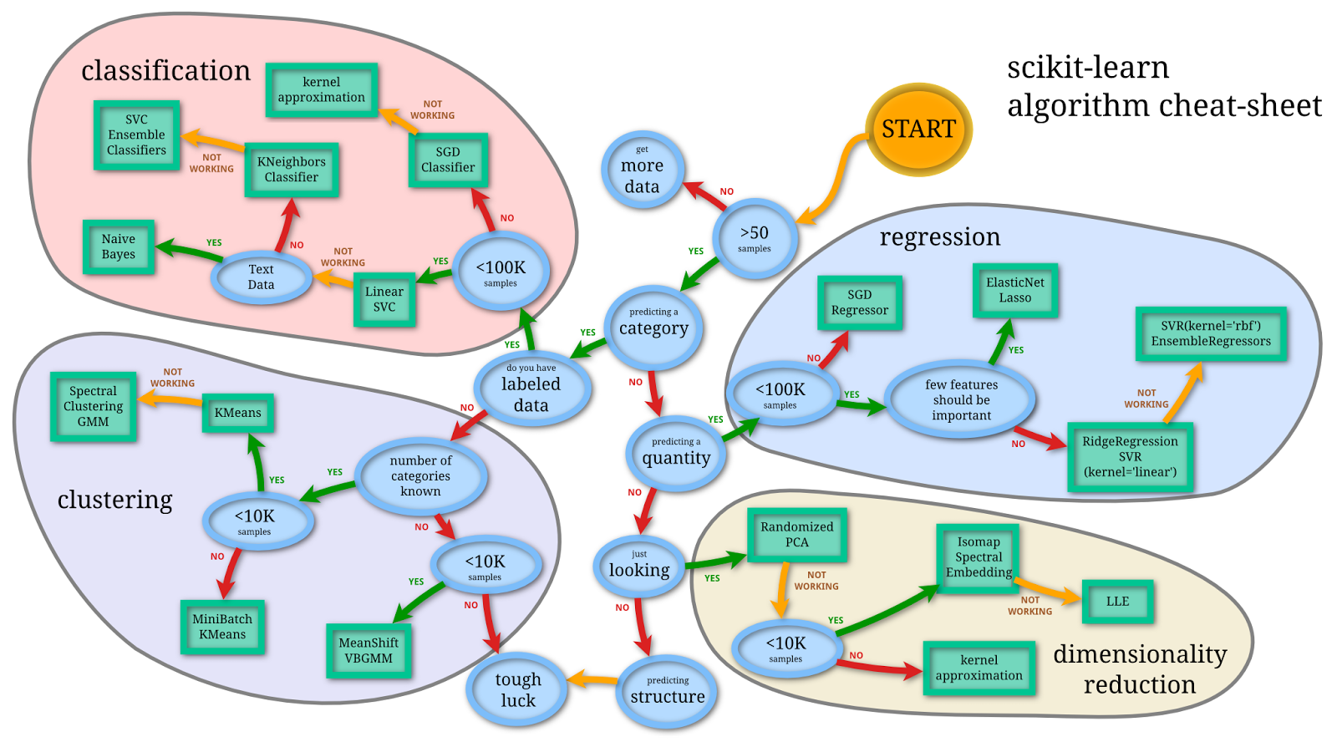
ALGORITHMS ABOUND
AND WE’LL SEE SOME OF THEM
Image credit: Andreas Mueller (2013)
Our goal: our own cheat sheet!
Notes:
Image from https://peekaboo-vision.blogspot.com/2013/01/machine-learning-cheat-sheet-for-scikit.html; CC0 license

Slide 18
what is ML useful for?

Slide 19
I’ll GO fIRST: what are some examples of how ml is used in astrophysics?

Slide 20
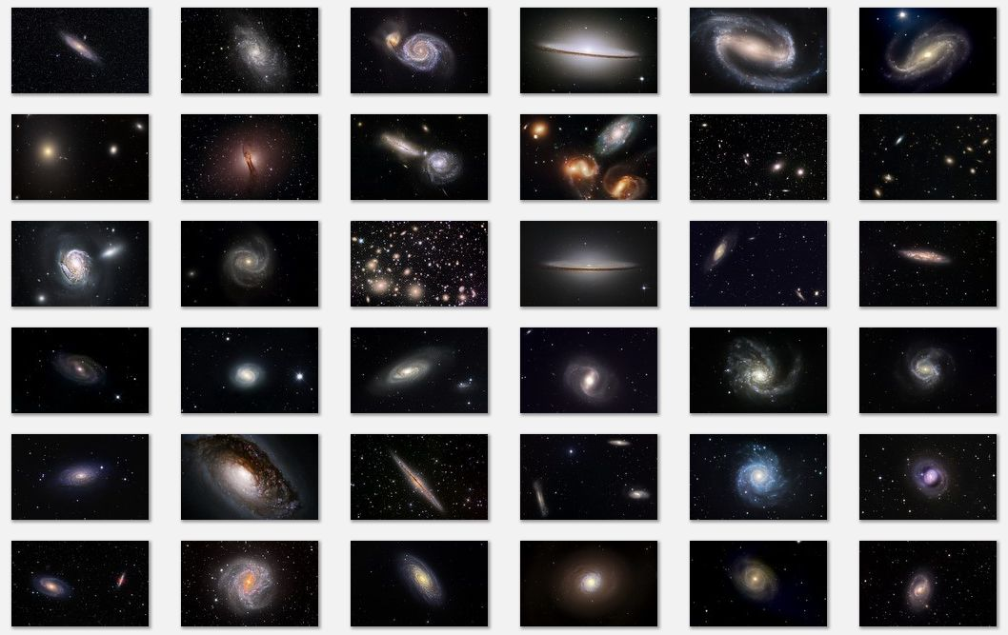
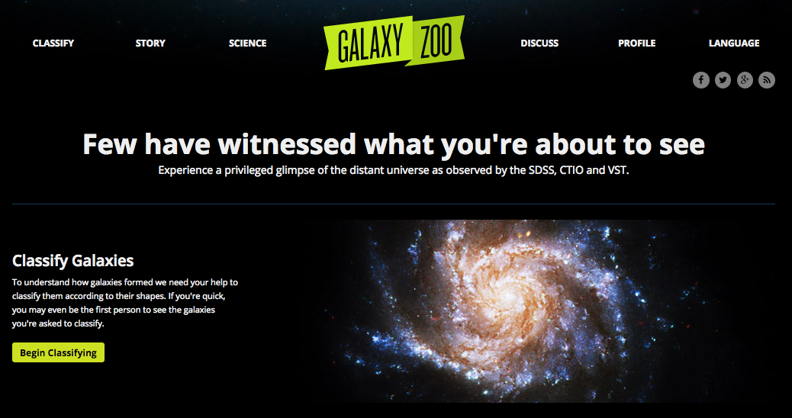
1. SAVE TIME
Galaxy morphology
Trained humans are the best classifiers.
But what to do when
you have millions of objects?
Citizen science
Automated Classification
via Machine Learning
(supervised/unsupervised
approach, see e.g. Hocking et al 2017)

Slide 21
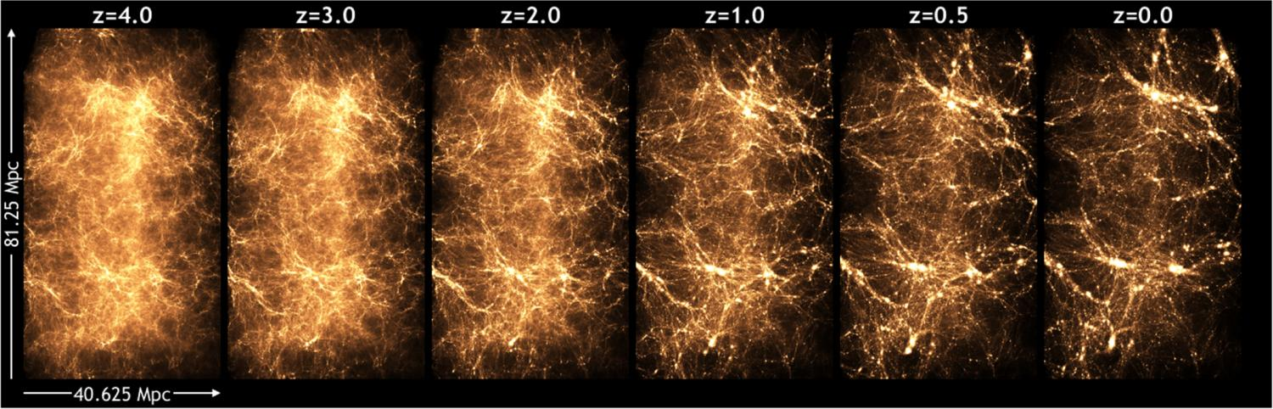
1. SAVE TIME (part 2)
expensive cosmological simulation ☺ ☹
Machine Learning Emulator
(learn the function that goes from initial conditions to final conditions!)
See e.g. the CAMELS project, https://arxiv.org/abs/2010.00619

Slide 22

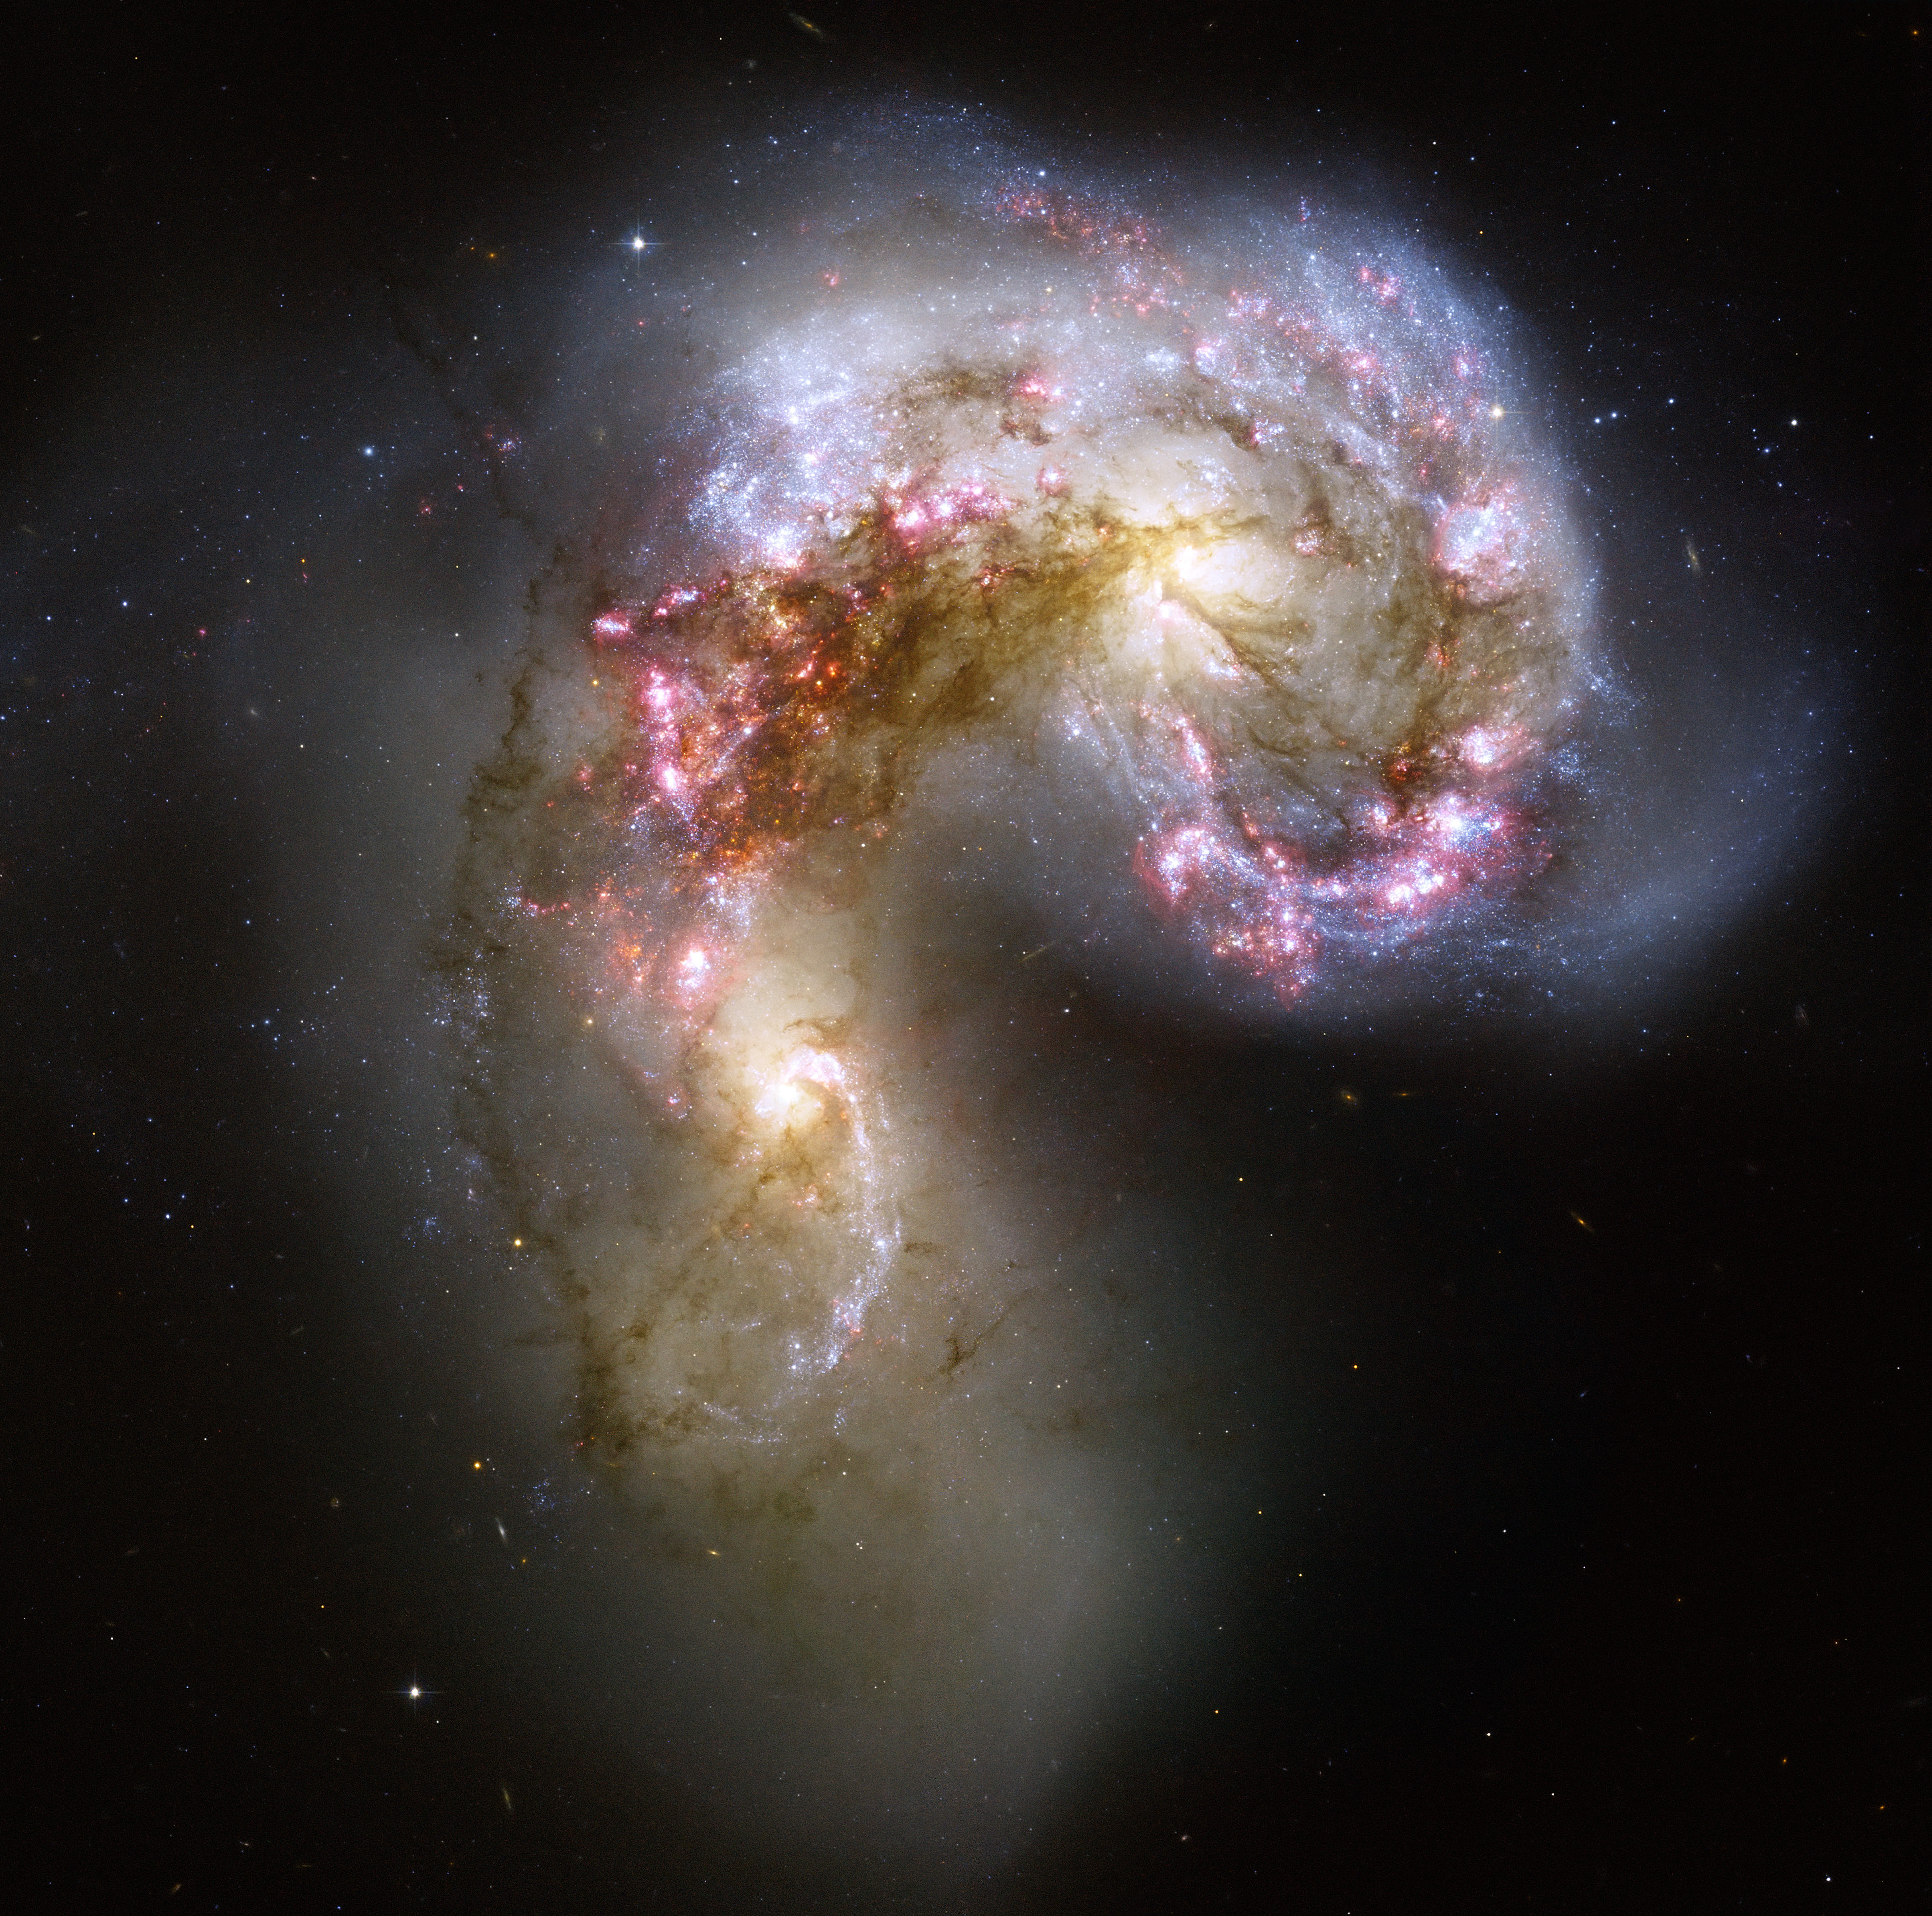
2. make model-free inference
(mitigate biases)
≠

Slide 23
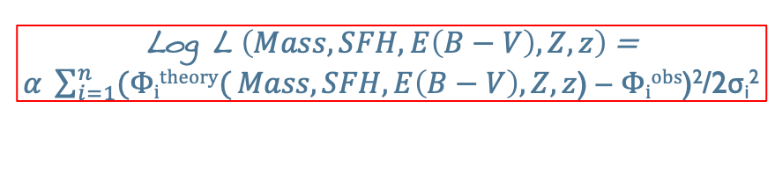
“Measuring”: learning by example (supervised)
Log L $\left(Mass, SFH, E\left(B−V\right), Z, z\right)$ =
$α \sum_{i=1}^{n}{(Φitheory(}Mass, SFH, E\left(B−V\right), Z, z$) – $Φiobs$)²/2σ_{i}²
Stellar Mass?
Figures from Skelton et al 2014

Slide 24
“Measuring”: learning by example (supervised)
Stellar Mass?
5 x 10⁸ M⊙
Figures from Skelton et al 2014

Slide 25
“Measuring”: learning by example (supervised)
Stellar Mass?
5 x 10⁸ M⊙
6 x 10⁹ M⊙
Figures from Skelton et al 2014

Slide 26
“Measuring”: learning by example (supervised)
Stellar Mass?
5 x 10⁸ M⊙
6 x 10⁹ M⊙
8 x 10⁸ M⊙
Figures from Skelton et al 2014

Slide 27
“Measuring”: learning by example (supervised)
Stellar Mass?
5 x 10⁸ M⊙
6 x 10⁹ M⊙
8 x 10⁸ M⊙
8 x 10⁹ M⊙
Figures from Skelton et al 2014

Slide 28
“Measuring”: learning by example (supervised)
Stellar Mass?
5 x 10⁸ M⊙
6 x 10⁹ M⊙
8 x 10⁸ M⊙
8 x 10⁹ M⊙
?
Figures from Skelton et al 2014

Slide 29
“Measuring”: learning by example (supervised)
Stellar Mass?
NO LIKELIHOOD
NO MODEL
5 x 10⁸ M⊙
6 x 10⁹ M⊙
8 x 10⁸ M⊙
8 x 10⁹ M⊙
?
2 x 10¹⁰ M⊙
Figures from Skelton et al 2014

Slide 30
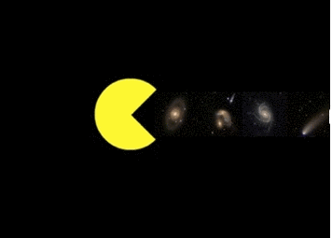
3. use higher-level
data products
Model based inference:
P(model | image) = mess ☹
Machine Learning

Slide 31
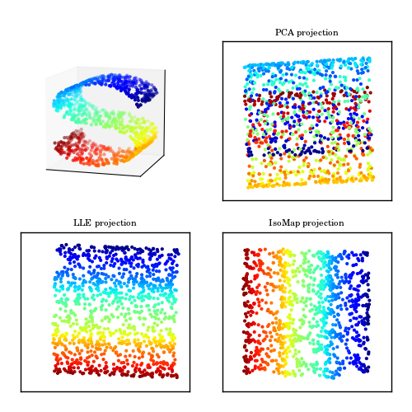
4. make problems tractable
via dimensionality reduction
By allowing us to
transfer knowledge
TRAINING DOMAIN
(SDSS data)
APPLICATION DOMAIN
(DES data)
Dominguez-Sanchez et al 2018
3D -> 2D with different degrees
of information loss
feature space
different depth,
PSF, seeing

Slide 32
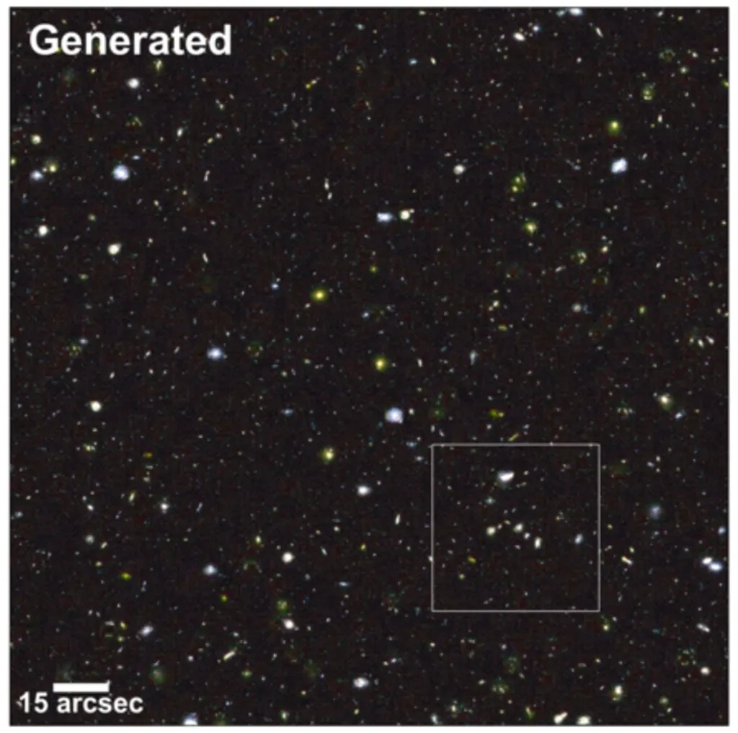
5. data-driven representation + Generative models
Enhanced realistic catalogs and data products
2. New intuitions from feature generation
3. Dimensionality reduction
FIND PICTURE
Smith and Geach 2019

Slide 33
Questions?

Slide 34
Fun Machine Learning readings Visual: http://www.r2d3.us/visual-intro-to-machine-learning-part-1/ Medium article https://medium.com/@ageitgey/machine-learning-is-fun-80ea3ec3c471 Also, the Python Data Science Handbook has a lot on this subject in the form of notebooks, and I’ll distributes my own book chapter (please do not post elsewhere!)

Slide 35
Let’s answer these questions (for the topics I’ll give in a minute)
Is this supervised or unsupervised ML?
Is this a classification or regression problem?
What could be useful features (data) to collect?

Slide 36
Gmail assigning your emails to
Primary/Promotions/Social
Predicting house selling prices (say, you are a real estate agent and wanna know how much you should list houses for)
Trending topics on Twitter

Slide 37
Guessing a college student’s major from personal information
Counting the number of people in a collection of pictures
Predicting the number of hours a student will sleep tonight

Slide 38
SUPervised learning

Slide 39
IMPORtant: you shouldn’t use all of your learning set to build your model.
It is customary to split the learning set into
a training set and test set
LABELS KNOWN
TEST SET (~25%)
TRAINING SET
(~75%)
By building a model on the training set and applying it
to the test set, you “mimic” what happens when your model sees new data
for which the labels are not known.
Otherwise you would be too optimistic! (note: you still are!)
Notes:
Notes: Size is arbitrary

Slide 40
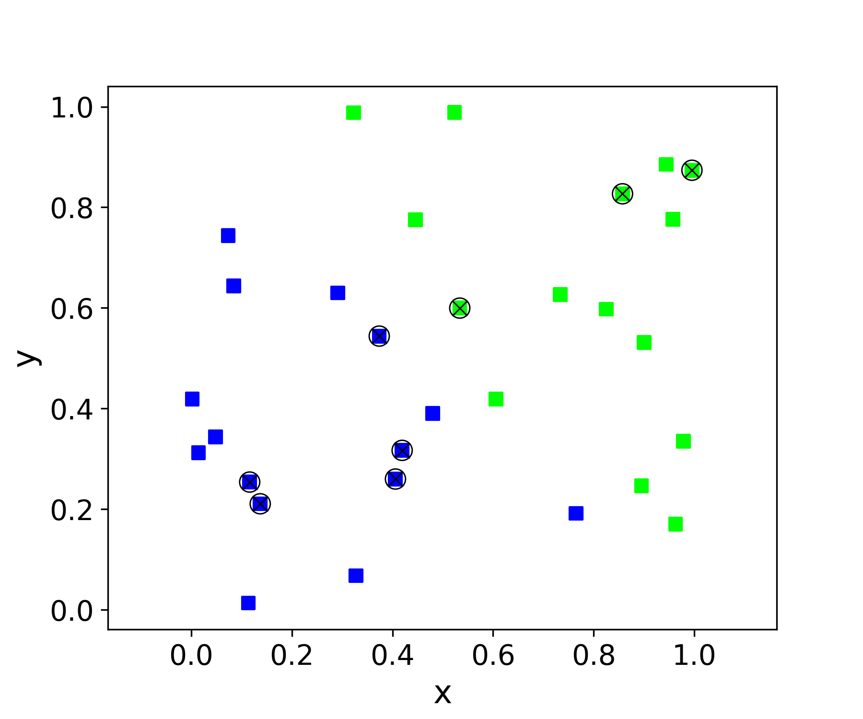
Crossed points = test set (selected at random)
Train set: used to build model
Test set: used to evaluate performance
Train score (error) = Performance on train set
Test score (error) = Performance on test set
Generalization score (error) =
Performance on new data
Test error is used as proxy
for generalization error

Slide 41
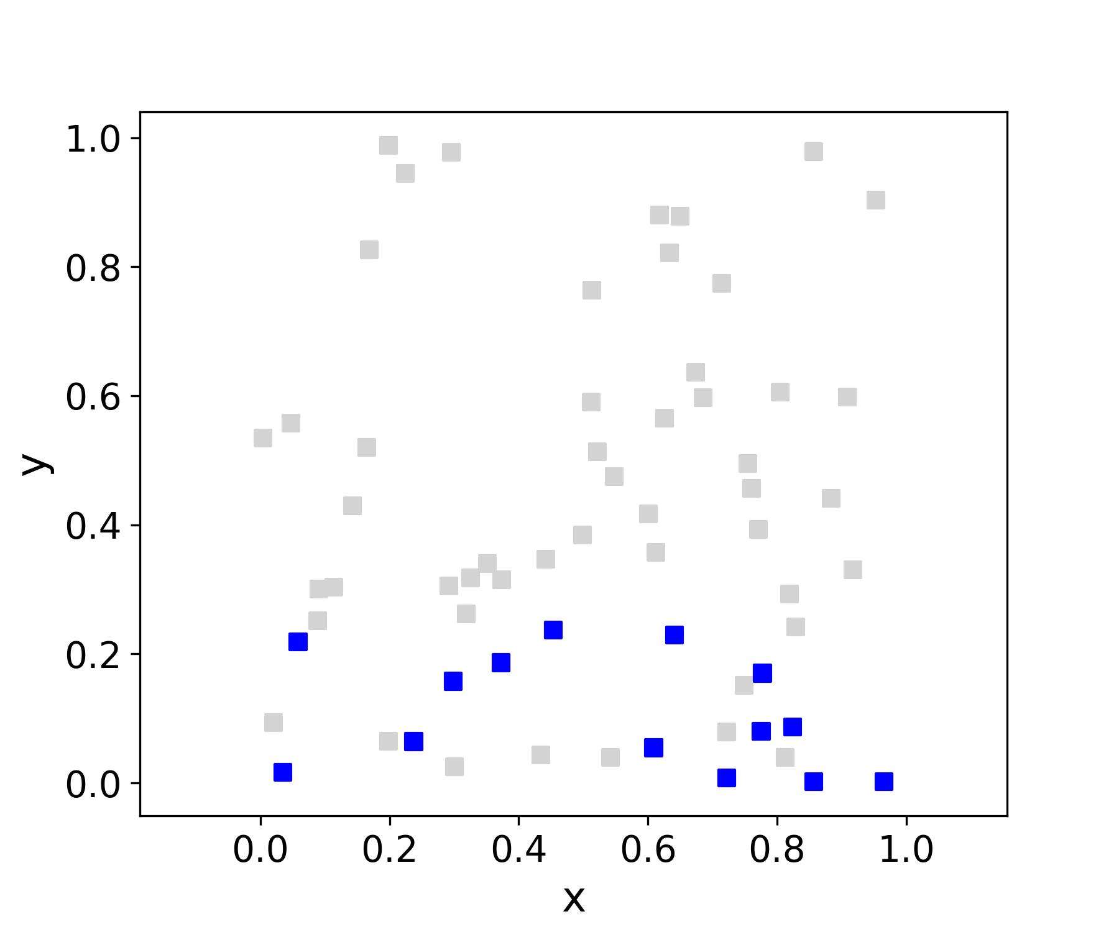
Test error vs generalization error Q: is this a good learning set for the gray-point population?
No, because it’s a very biased view of the larger population:
We need to be mindful of application domain.
Sometimes this is hard to recognize!

Slide 42
Summary of desired qualities in learning set
Size (large enough to build a good model)
Well-chosen representation
Statistically representative of application domain

Slide 43
MAIN steps for building a supervised model (the ones with * will change)
Arrange the data into features and target matrices/vectors.
Split them into a training set and a test set∗.
Select the machine learning algorithm you want to use, and its parameters∗.
Build the model by applying the selected algorithm to the training set. This will create a tentative (implicit) input-output relationship. If you are using scikit-learn, this corresponds to applying the “.fit” method.
Apply the model to the features of the test data to predict the target property of test data. If you are using scikit-learn, this corresponds to applying the “.predict”method.
Estimate the performance of your model by using an appropriate evaluation metric to compare the predicted and true target property of the test data.
Rejoice (unlikely), figure out what is not working out and repeat from 1 (likely).

